Slide 1
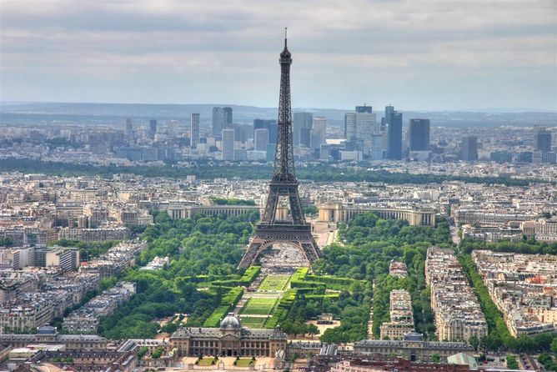
Priorities & Challenges for Paris
Malte Meinshausen
Climate Change Conversation Seminar, 17th March 2015
The University of Melbourne

Slide 2
Four Priorities
Zero Carbon Long-Term Target. Full decarbonisation.
Targets for 2025/2030. Get back to 1990 emissions by 2030.
Carrot Build Leaders. Create ‚race to the top‘ / ‚Clubs of the willing‘ atmosphere. Renewables, Air Pollution, Innovation, Trade Balances, Electrification, ... Other co-benefits.
Stick Strengthen Polluters/Beneficiary pays principle. Adaptation funding, Loss & Damage.
To at least stay <2°C
Increasing Effectiveness

Slide 3
Many Challenges
How to fullfill ‚global agreement‘ expectation while not going for lowest common denominator?
G20 = ¾ of global emissions.
China, US & EU = ½ of global emissions.

Slide 4
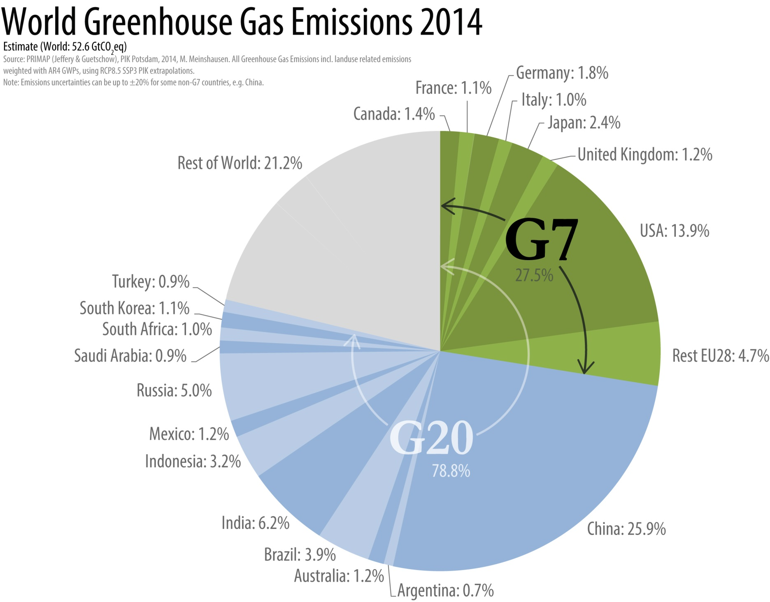

Slide 5
Many Challenges
How to fullfill ‚global agreement‘ expectation while not going for lowest common denominator?
G20 = ¾ of global emissions.
China, US & EU = ½ of global emissions.
How to create fair support regime without taking mitigation hostage? ‚Everybody on his own‘ vs. ,Expectation for Finance‘. Mitigation is seen as main priority for developed countries. Adaptation for developing. Public finance will not be able to fullfill expectations. How to create market conditions for private finance to step in? Negotiation dynamic danger: ‚If you don‘t pay us, we don‘t mitigate‘
How to build trust with insufficient or murky 2025/2030 INDCs / targets?
How to adjust INDCs, once they are communicated?
How to integrate Loss&Damage?
How to create effective primary forest protection?
....

Slide 6
Why Zero Emissions?

Slide 8
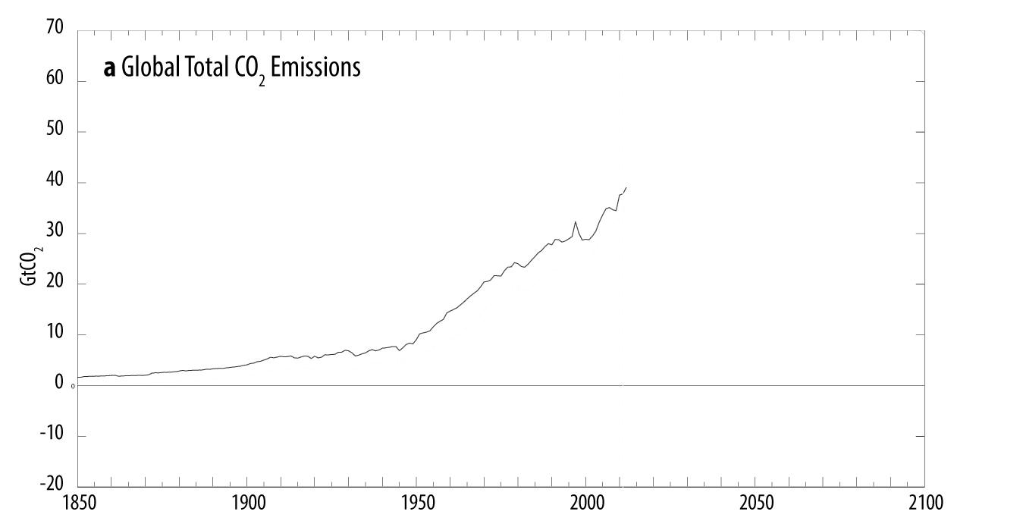
Meinshausen et al. in preparation.

Slide 9
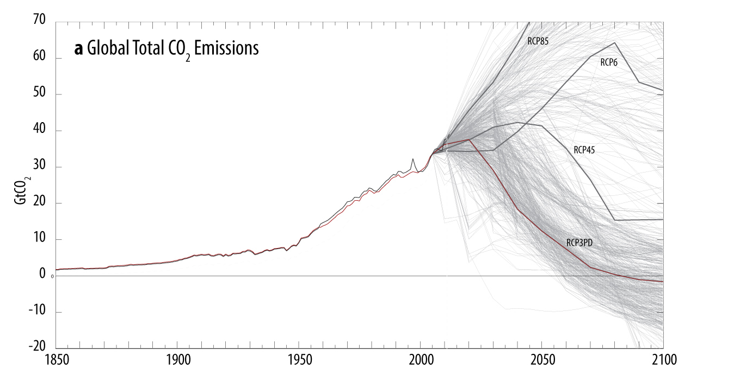
Meinshausen et al. in preparation.

Slide 10
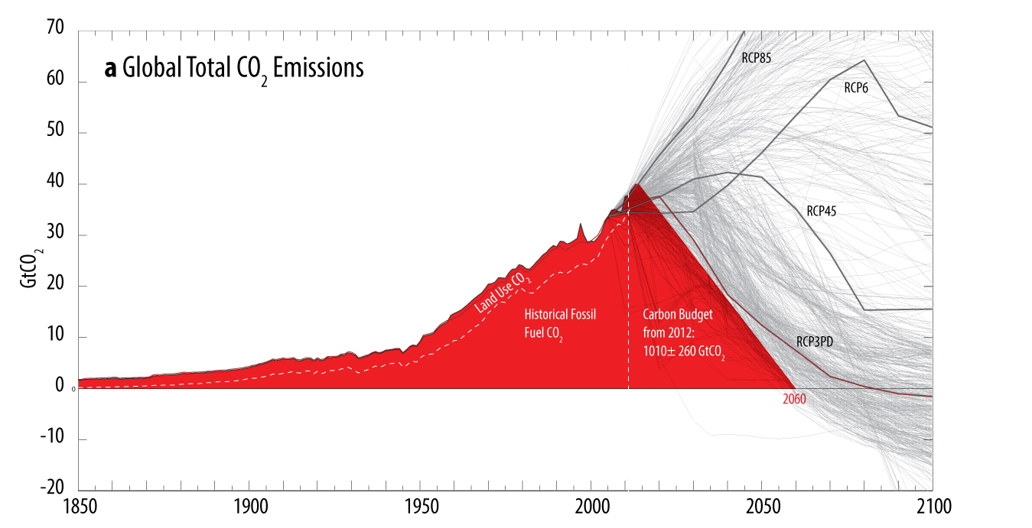
Meinshausen et al. in preparation.

Slide 11
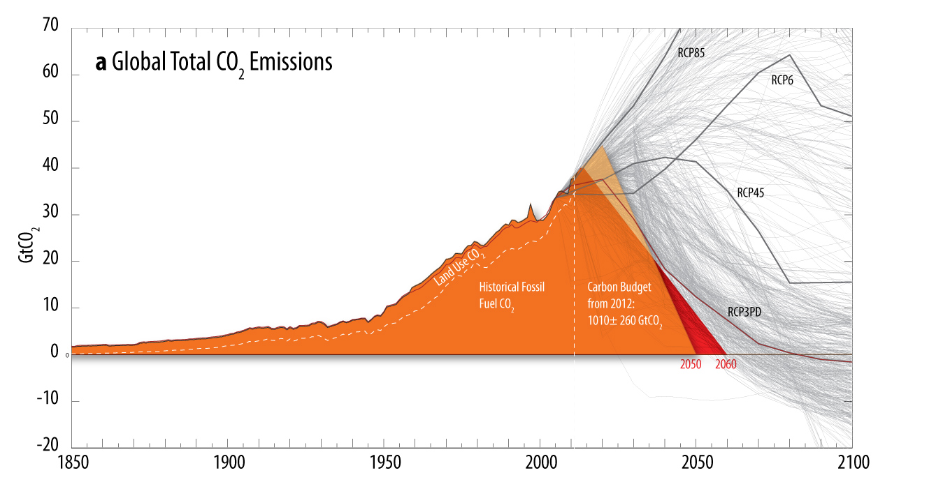
Meinshausen et al. in preparation.

Slide 12
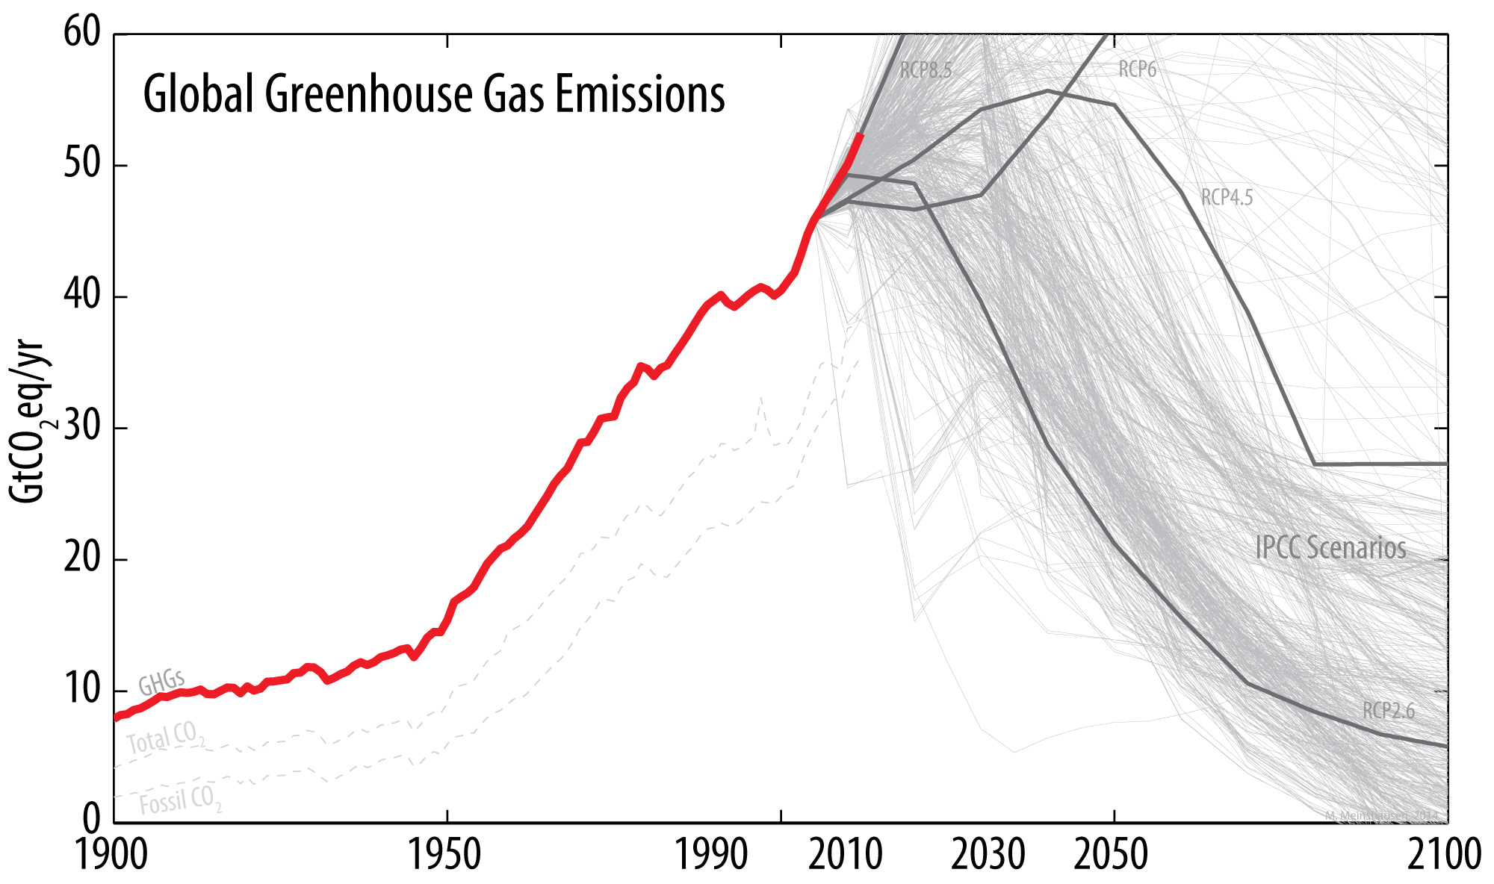

Slide 13
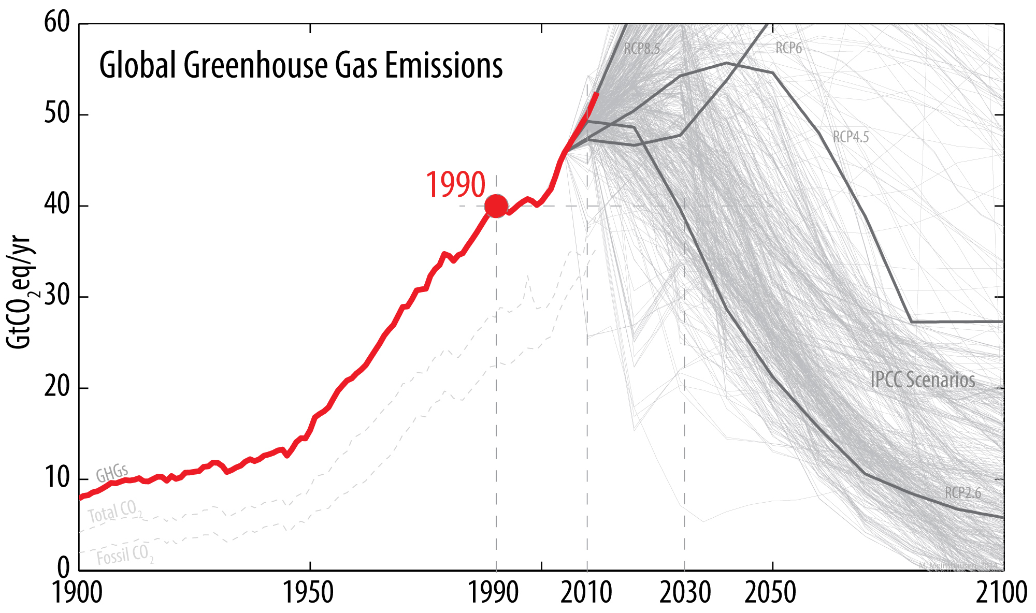

Slide 14
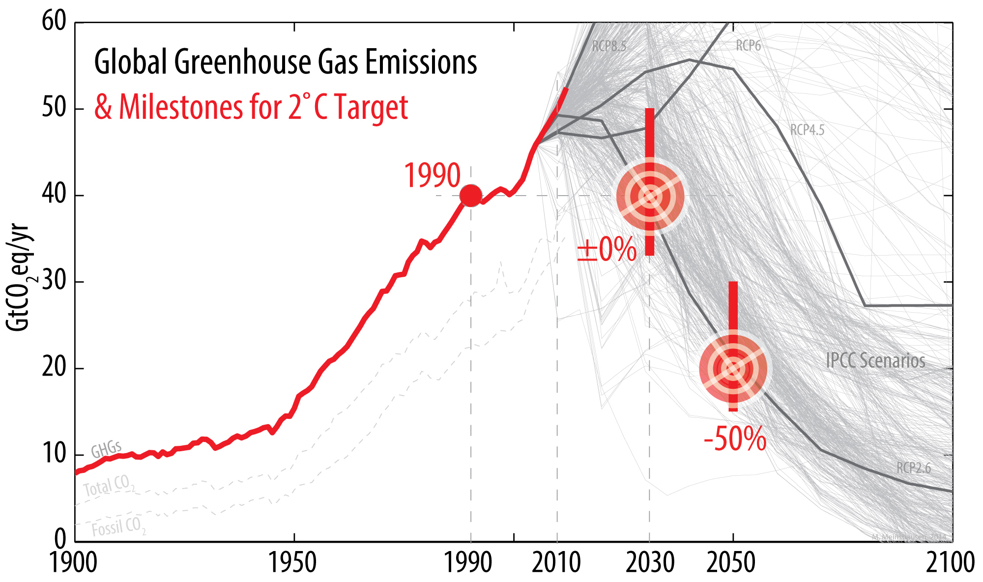

Slide 15
Further Info
Link Collection: http://www.sustainable.unimelb.edu.au/paris-and-beyond-resources
Our Video from Lima: http://climate-energy-college.net/
Next seminar: Key negotiator from Tuvalu, 21st April: Ian Fry.

